Slide 1
CONSUMER COMPLAINTS
ANALYSIS
Presented by: Gabriel

Slide 2
OBJECTIVE
To gain useful insights that can help to mitigate complaints and eventually increase revenue by improving customer satisfaction

Slide 3
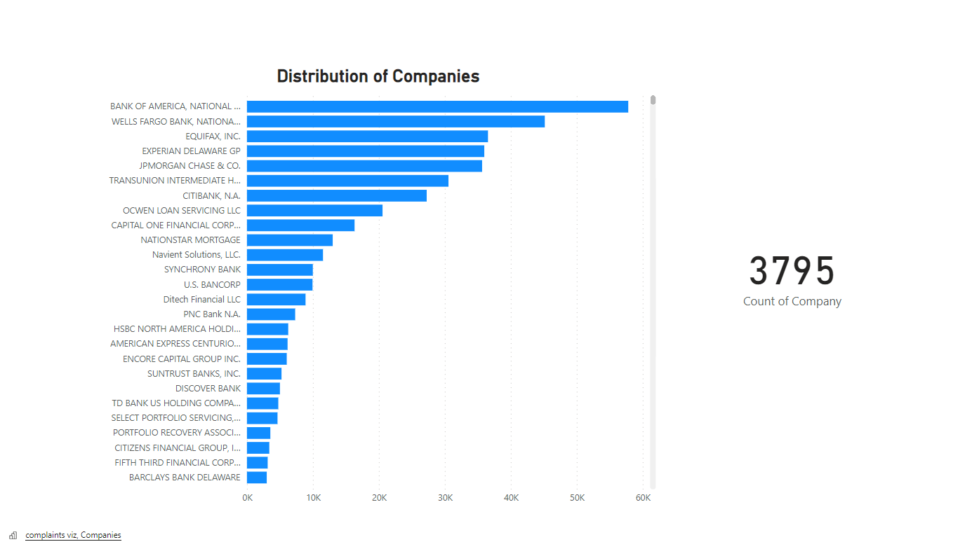
There are 8 companies with over 20k complaints
All the companies with significant frequency of issues are financial institutions

Slide 4
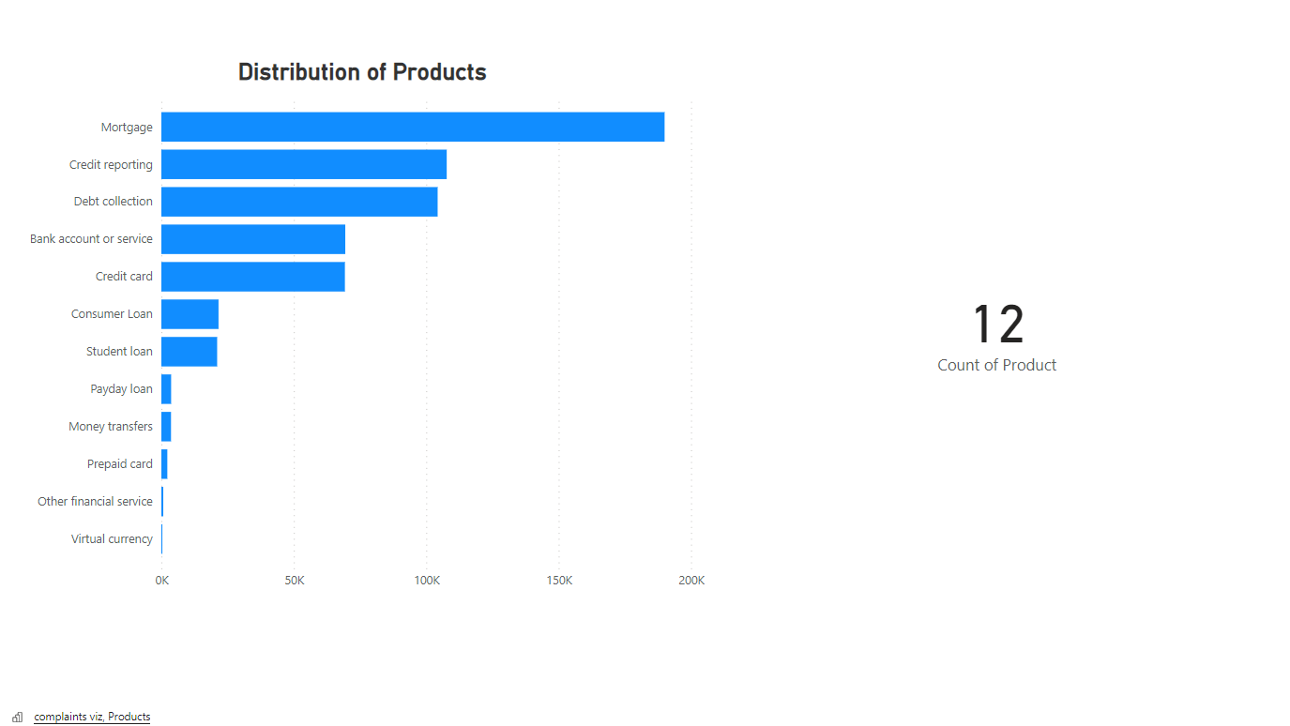
All the services are financial
There are 12 Products under observation

Slide 5
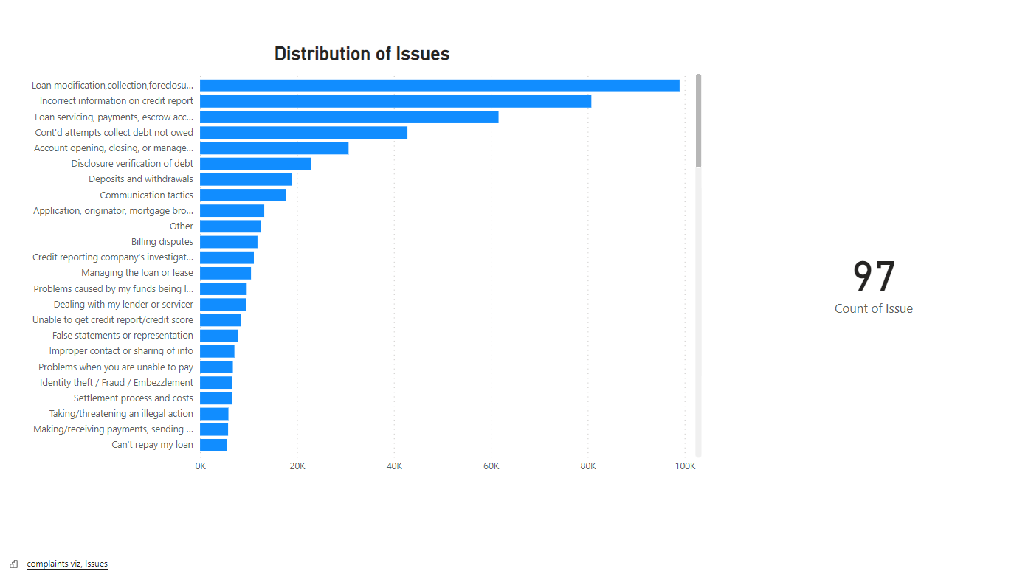
There are 97 distinct Issues
Only 6 issues are reported over 20k times
Loans and Debt make up a high frequency of the issues

Slide 6
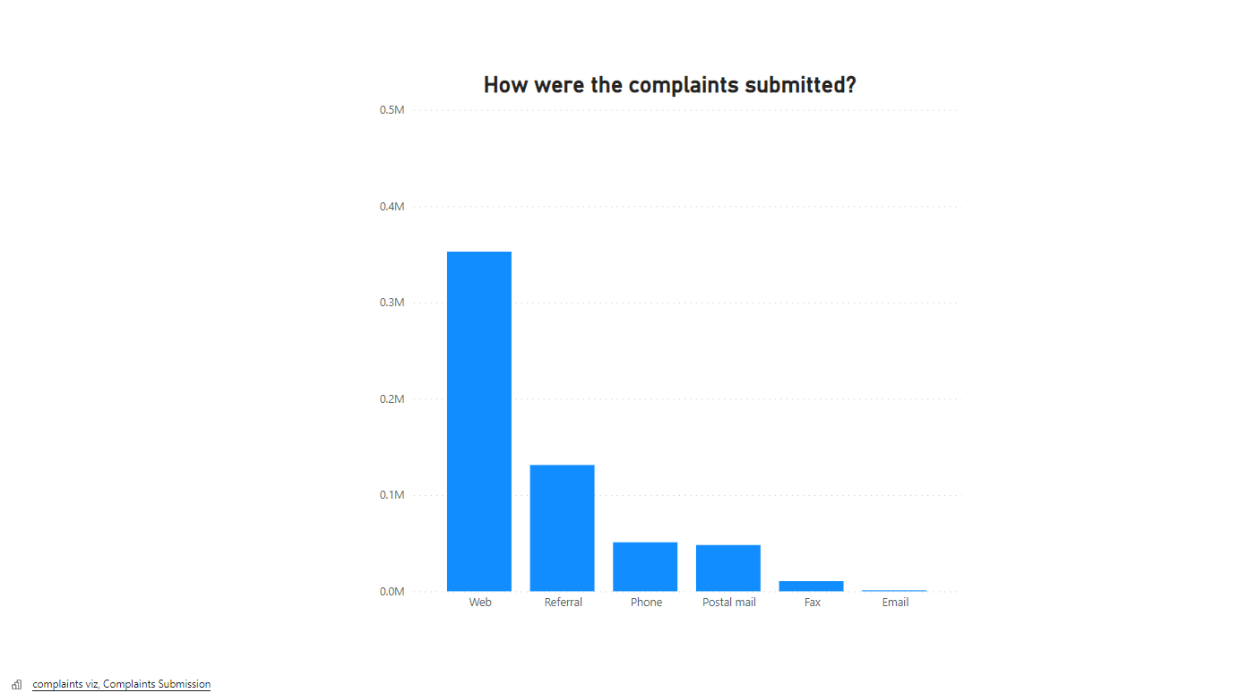
Over 60 percent of the complaints are made by internet using customers
Post and Fax were significantly used more than email.
This could mean there’s a good number of older generation folk among the complaints

Slide 7
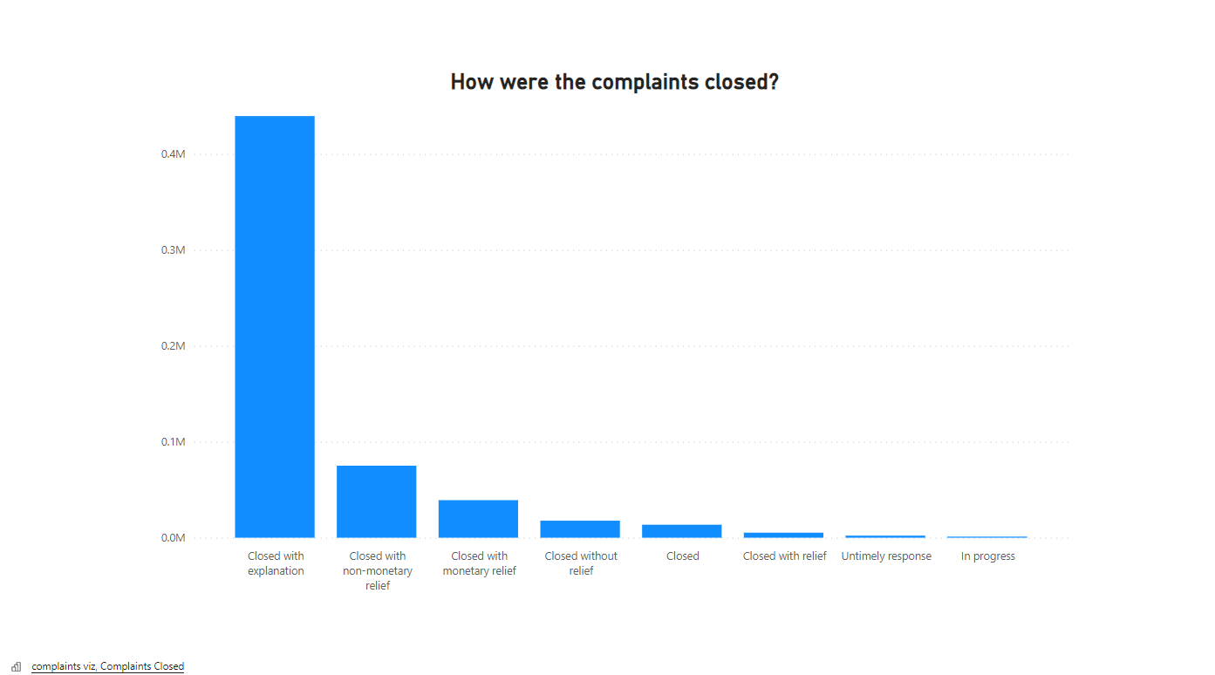
75 percent of the complaints were closed by explanations
Most of the issues stemmed from inadequate information
Only a very small percentage of issues have not been settled

Slide 8
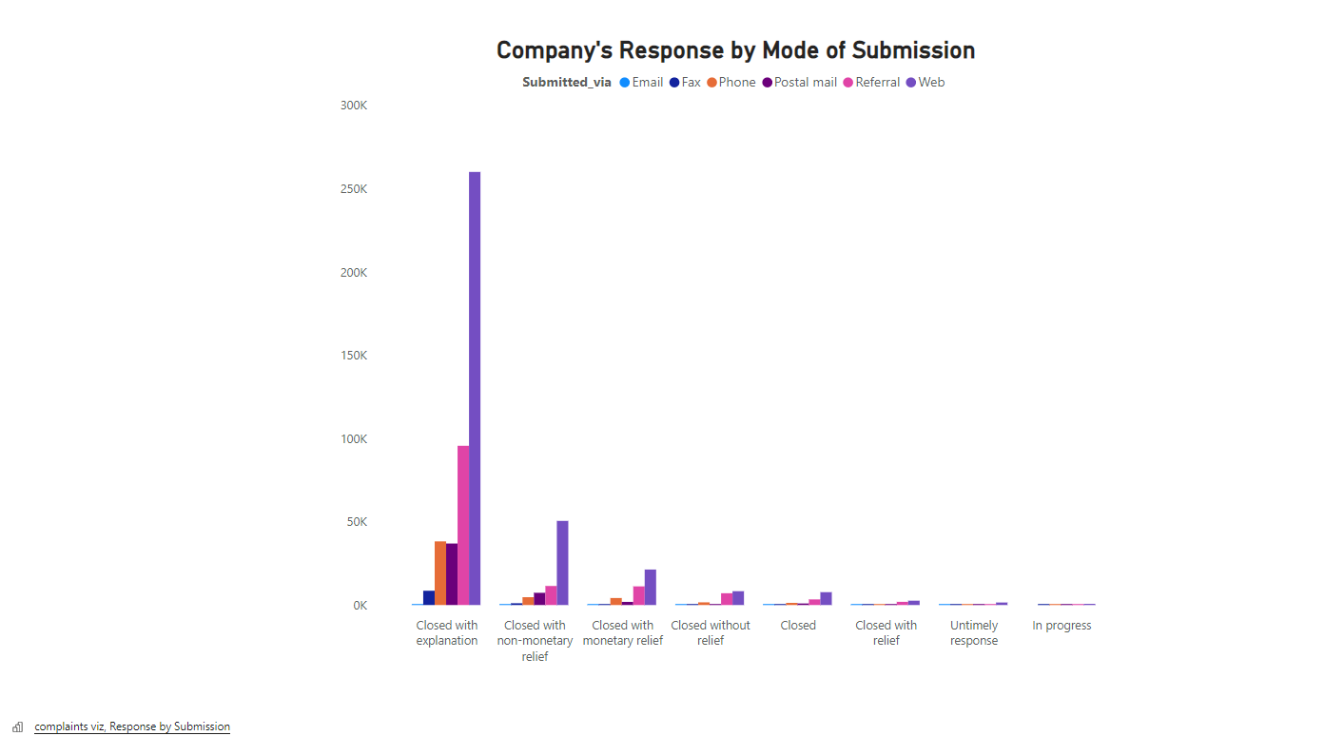
The companies response rate is consistent with the rate of submission
The companies pay adequate attention to all kinds of issues regardless of mode of submission

Slide 9
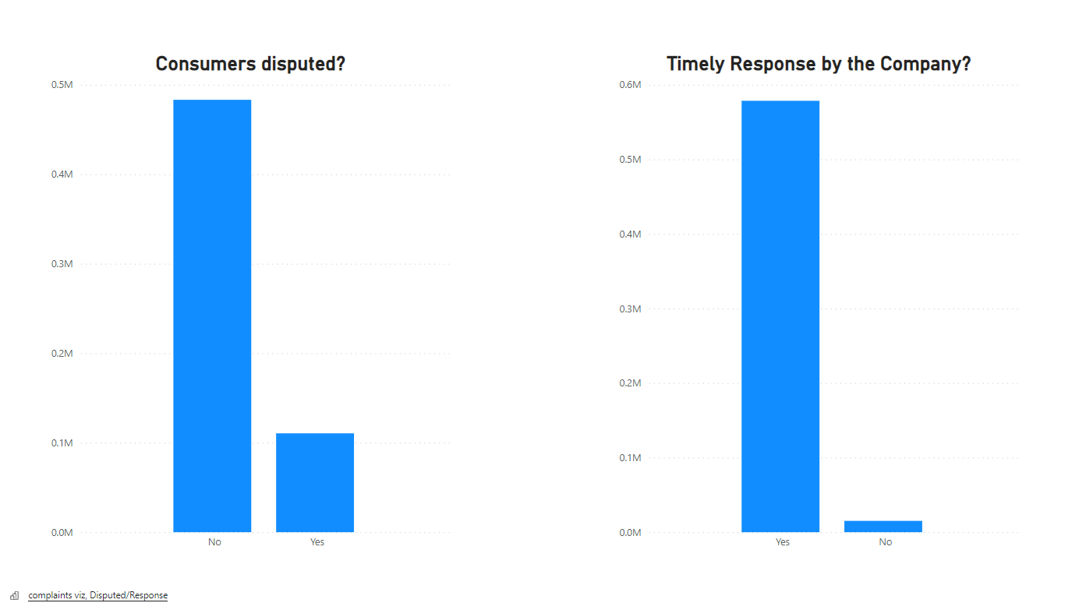
Most complaints were settled without customers disputing
Companies have a 97 percent rate of timely response
There is some correlation between timely response and consumers disputing

Slide 10
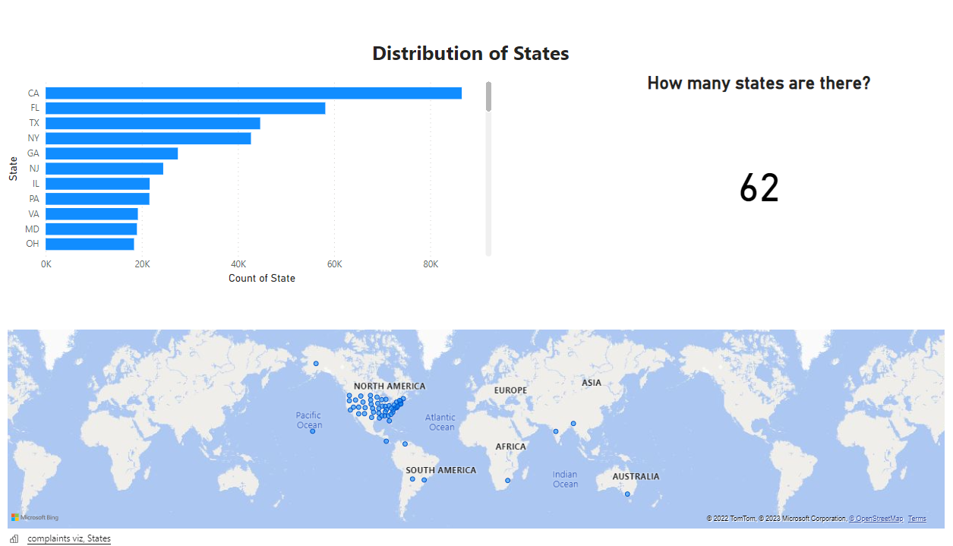

Slide 11
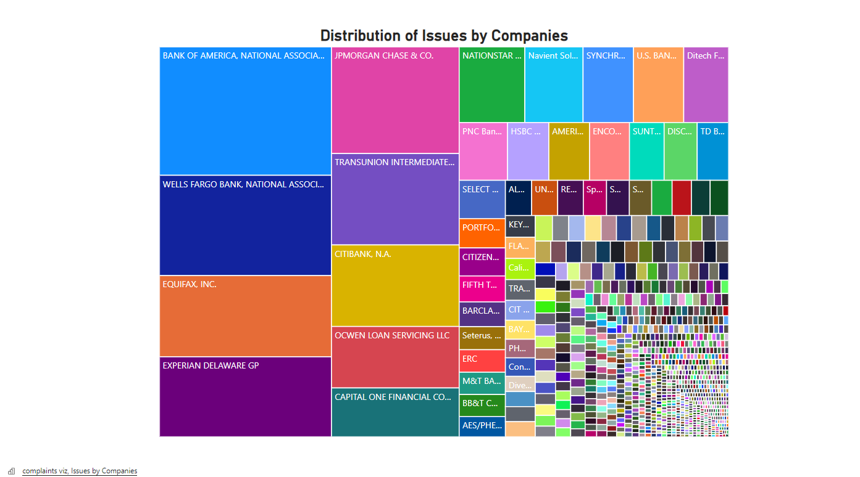

Slide 12
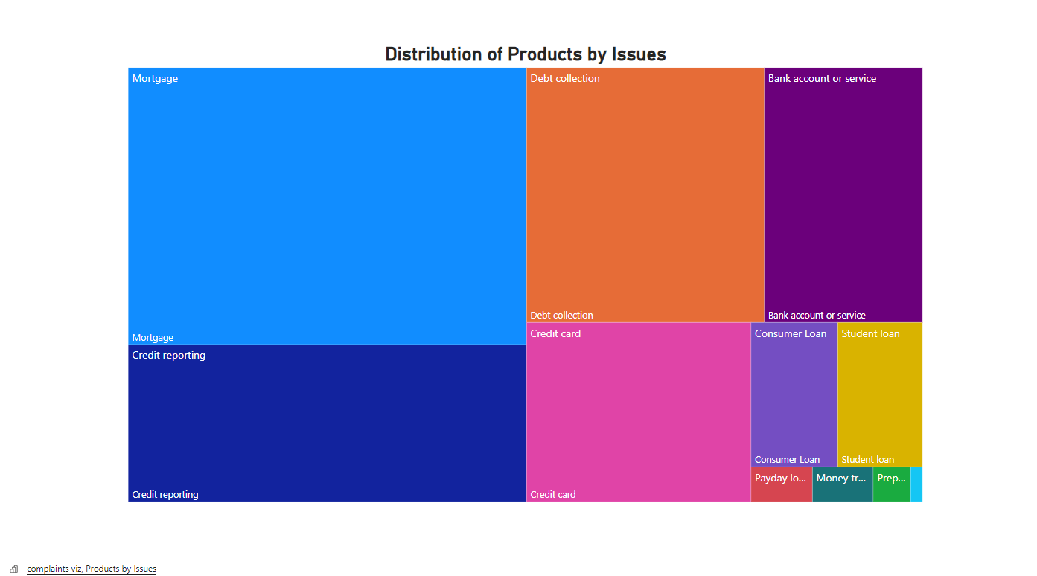

Slide 13
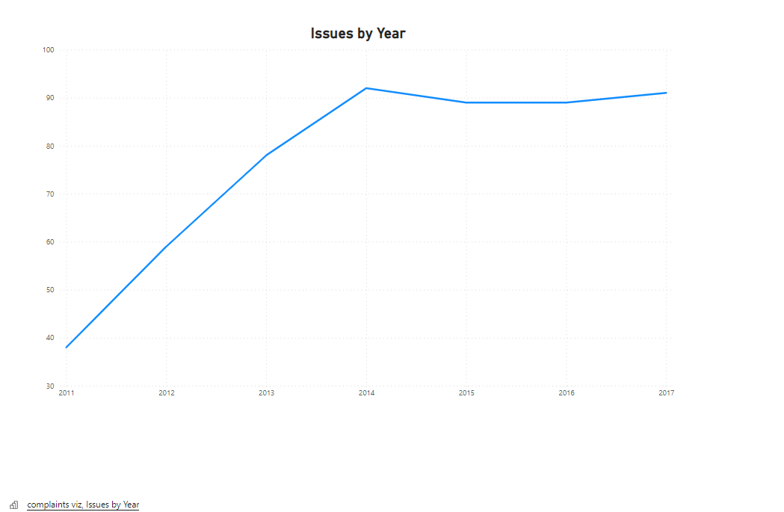
complaints viz - Power BI
The peak year for issues is 2014
Issues maintain a somewhat steady level from 2015

Slide 14
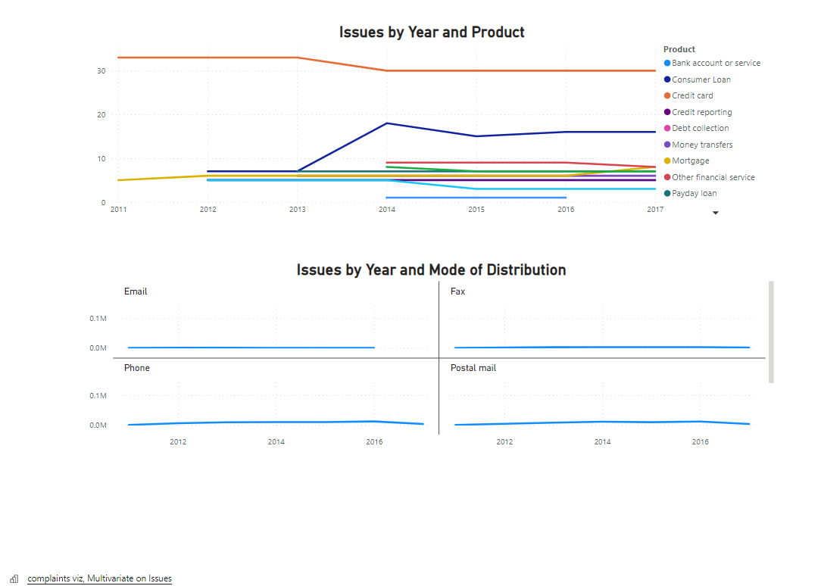
Product type plays no significant role in why frequency of issues is stagnant after 2015
Issues are the same over time for every mode of submission except via web

Slide 15
CONCLUSIONS
Issues submitted via web should be given highest probability
There will be significant reduction in issues if there is timely response at all times
Banking institutions registered the most issues with Mortgage, Credit reporting, and debt collection having the largest impact.
Issues stopped increasing after 2014 and remained at a level frequency
More recent data should be collected to understand latest trends in issues and how they can be tackled.

Slide 16
THANK YOU

